Slide 1
Why must students be taught the connections between phonemes and graphemes in English?
The Alphabet Arc
Lunch and Learn
May 4, 2022

Slide 2
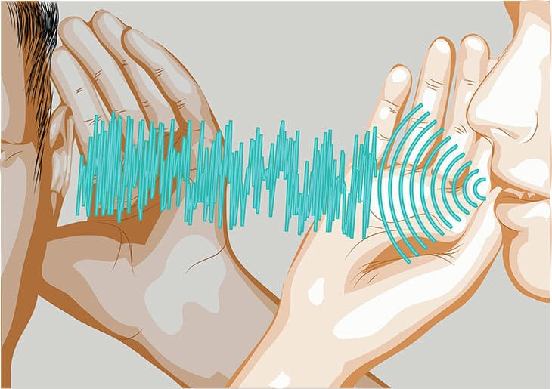
Reading depends on speech sounds (Moats, 2020).
Print is based on speech sounds; print was invented to represent the phonemes within the English language
and
English is a morphophonemic language!

Slide 3
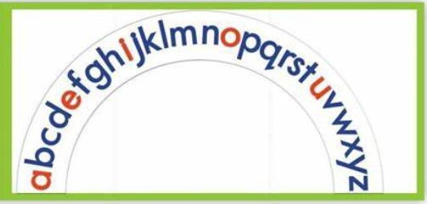
The Alphabet Arc
🍎Recognizing letters,
sounds and combinations
of letters and sounds, is a
skill that is needed to read
unfamiliar words
independently.
🍎Having letter-sound
knowledge will allow children
to make the link between the
unfamiliar printed words to
their spoken language
knowledge.
english-cf-2017.docx (live.com)

Slide 5
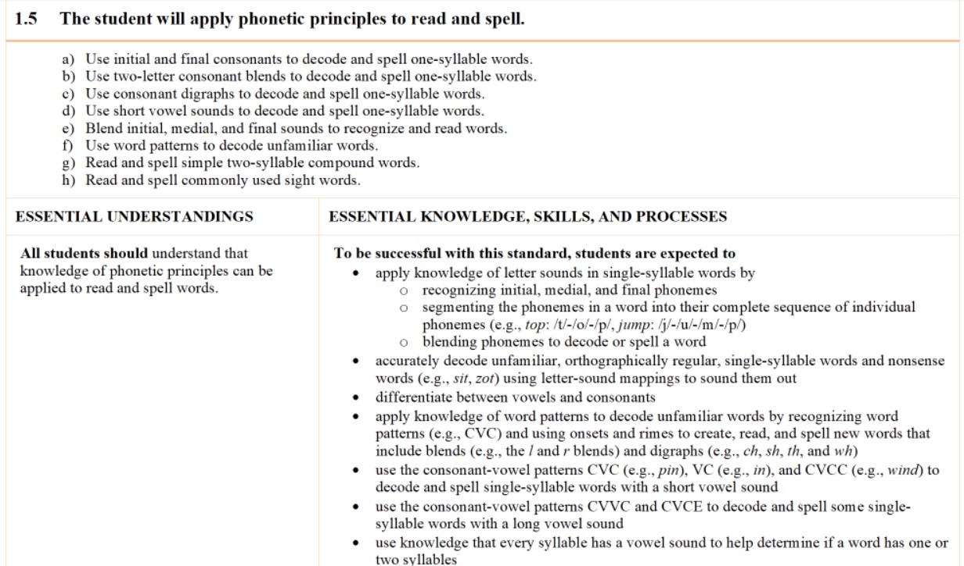

Slide 6
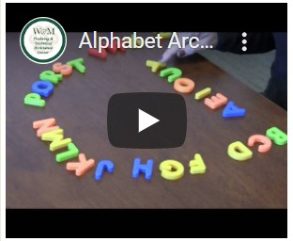
The Alphabet Arc Multisensory Structured Language Instruction and Teaching Series | W&M School of Education (wm.edu)
How might we use the alphabet arc?
Practice the sounds of the letters
Practice the names of the letters
Make words
Learn before and after
Replace the alphabet writing portion of an
OG Lesson
Other ideas - https://www.thedyslexiaclassroom.com/blog/three-ways-to-use-an-alphabet-arc-for-sequencing

Slide 7
Resources:
How to Build an Alphabet Arc
https://www.bing.com/videos/search?q=alphabet+arc+videos&view=detail&mid=309F2C25521433952C9A309F2C25521433952C9A&FORM=VIRE
Interactive Alphabet Arc (Texas)
https://dl.esc4.net/rla/alphabet-arc/english.html
How To Video to Support Use of the Interactive Alphabet Arc
Florida Center for Reading Research – Kindergarten Student Center Activities
https://fcrr.org/sites/g/files/upcbnu2836/files/media/PDFs/student_center_activities/k1_phonics/k1_letter_recognition/k1_p003_alphabet_arc.pdf

Slide 8
Resource that you might move into from the Alphabet Arc: Beginner Word Work Mat (ufl.edu)

