Slide 1
Word Problems?
No Problem!
Multi-Step Problems

Slide 2
www.sarahpowellphd.com
srpowell@austin.utexas.edu
@sarahpowellphd
119

Slide 3
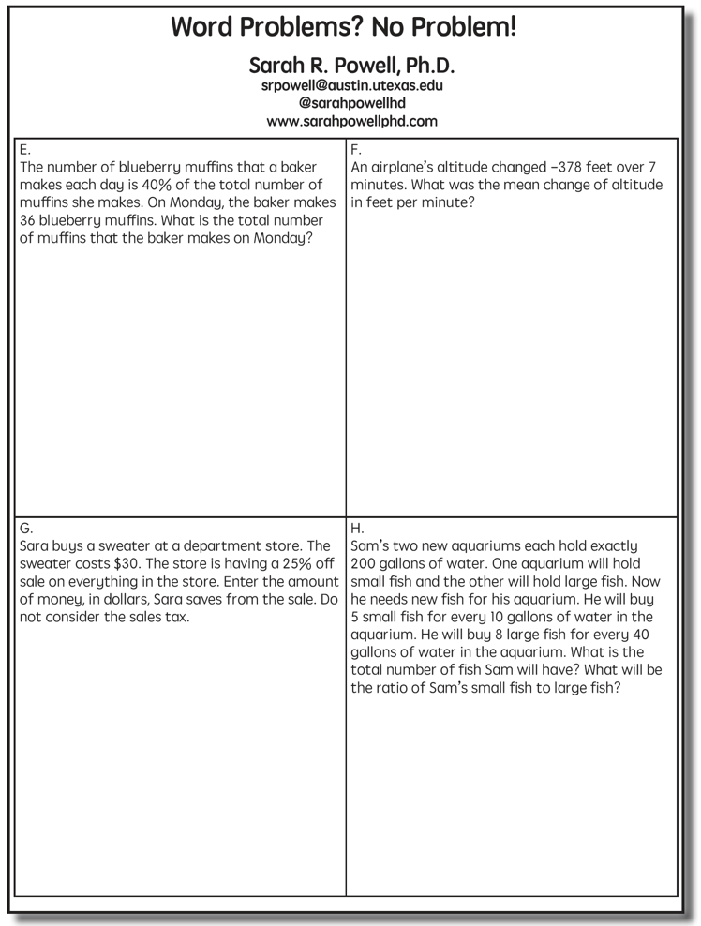

Slide 4
Teaching Problem Solving
Have an attack strategy
Teach word-problem schemas

Slide 5
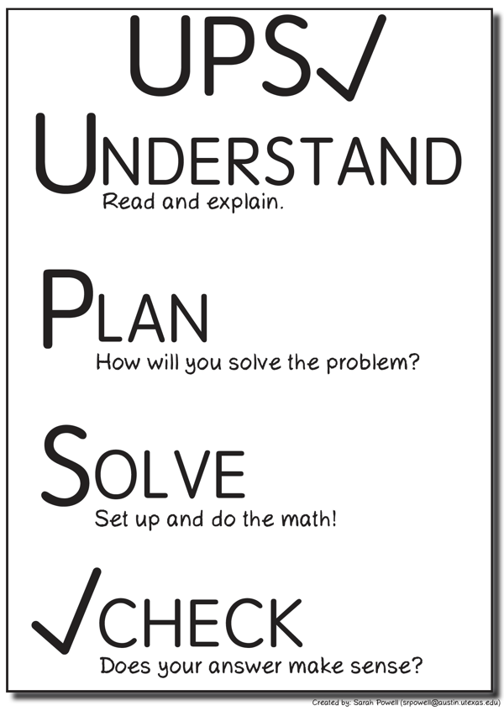
Have an attack strategy

Slide 6
Have an attack strategy
https://jamboard.google.com/d/1m_R2O9nSwwj9B05bSeZ6r2fJQBYp667dk7M3ys2AD1g/edit?usp=sharing

Slide 7
Teach word-problem schemas
Total
Equal Groups
Difference
Comparison
Change
Ratios/Proportions

Slide 8
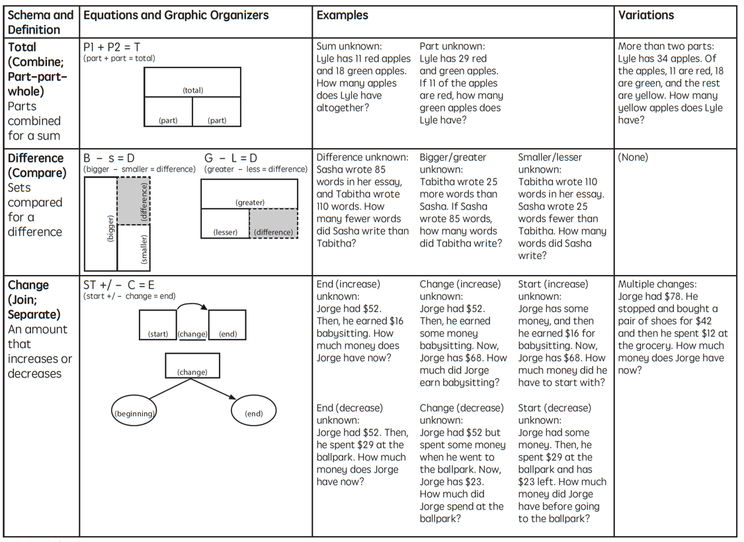

Slide 9
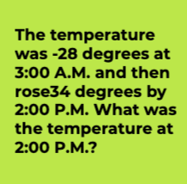
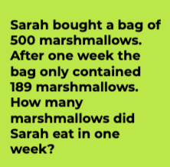
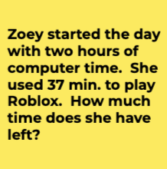

Slide 10
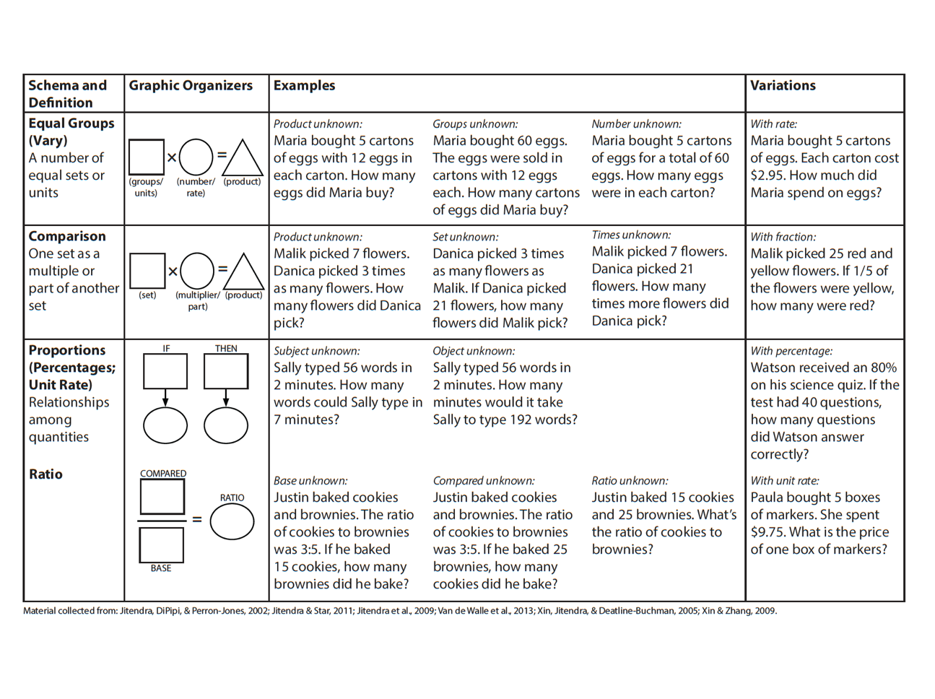

Slide 11
Equal Groups
Groups multiplied by number in each group for a product
Mark has 2 bags of apples. There are 6 apples in each bag. How many apples does Mark have altogether?
Mark has 12 apples. He wants to share them equally among his 2 friends. How many apples will each friend receive?
Mark has 12 apples. He put them into bags containing 6 apples each. How many bags did Mark use?

Slide 12
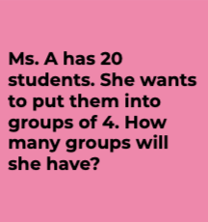
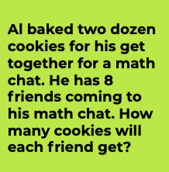
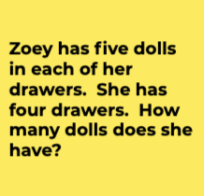

Slide 13
Comparison
Set multiplied by a number of times for a product
Jill picked 6 apples. Mark picked 2 times as many apples as Jill. How many apples did Mark pick?

Slide 14
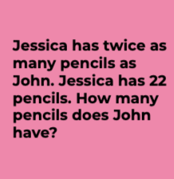
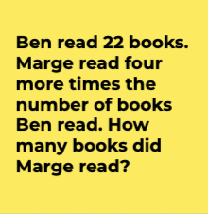

Slide 15
Ratios/Proportions
Description of relationships among quantities
Sally typed 56 words in 2 minutes. At this rate, how many words could Sally type in 7 minutes?
Margarita baked cookies and brownies. The ratio of cookies to brownies was 3:5. If she baked 25 brownies, how many cookies did she bake?
Xin et al. (2005)

Slide 16
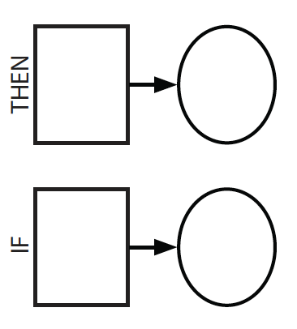
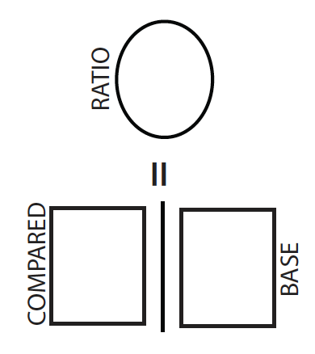
Ratios/Proportions
Description of relationships among quantities
Xin et al. (2005)

Slide 17
Equal Groups
“Are there groups with an equal number in each group?”
Comparison
“Is a set compared a number of times?”
Ratios/Proportions
“Are there relationships among quantities - if this, then this?”

Slide 18
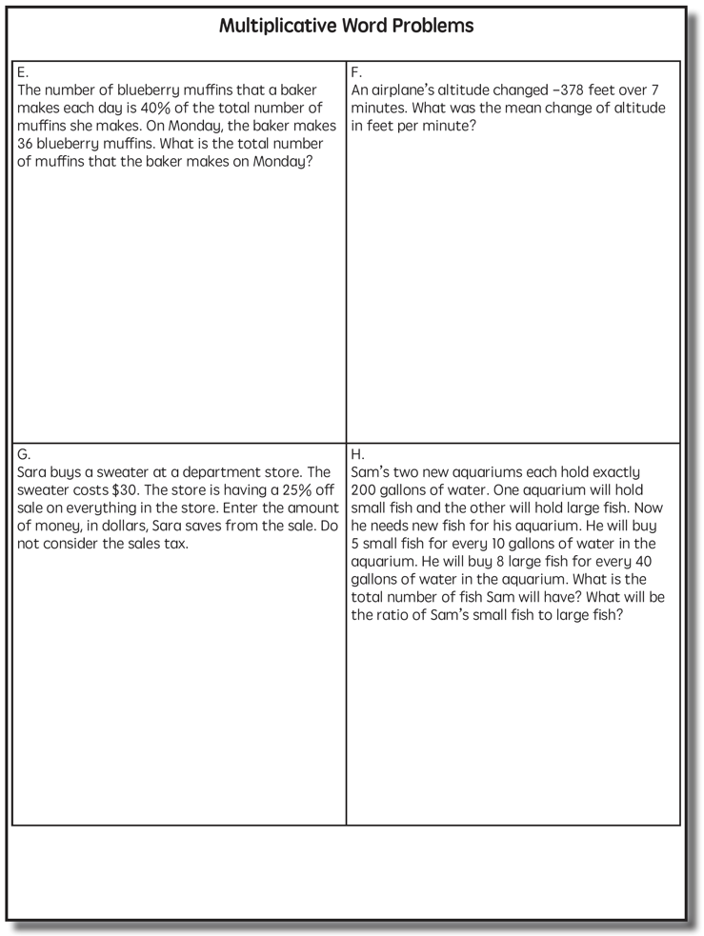
Ratios/Proportions

Slide 19
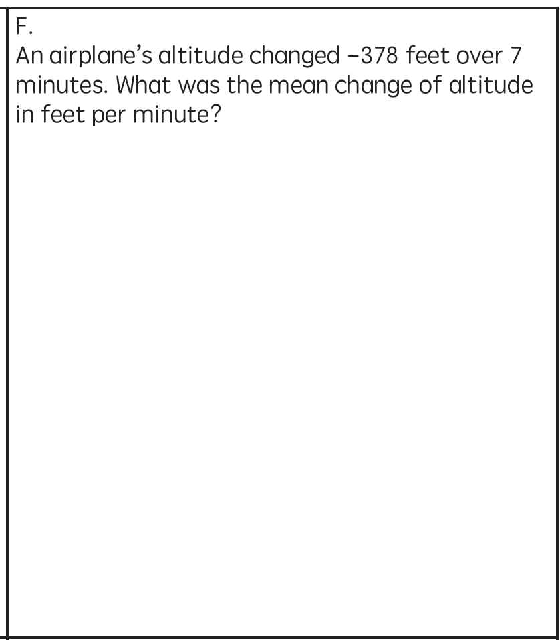
Ratios/Proportions

Slide 20
Ratios/Proportions
What’s a Ratios/Proportions problem?

Slide 21
Schema Quiz Time!

Slide 22
Equal Groups
Grade 4 PARCC

Slide 23
Ratios/Proportions
Grade 5 STAAR

Slide 24
Comparison
Grade 4 Smarter Balanced

Slide 25
Teach word-problem schemas
Total
Equal Groups
Difference
Comparison
Change
Ratios/Proportions

Slide 26
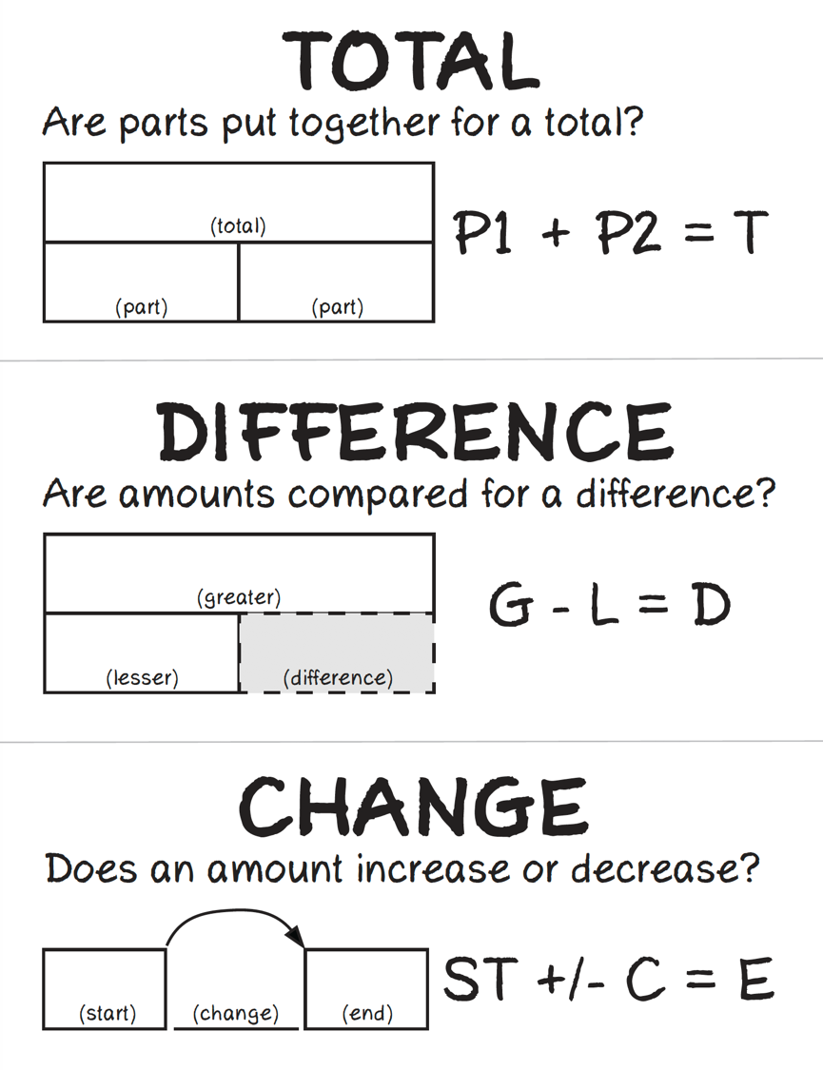

Slide 27
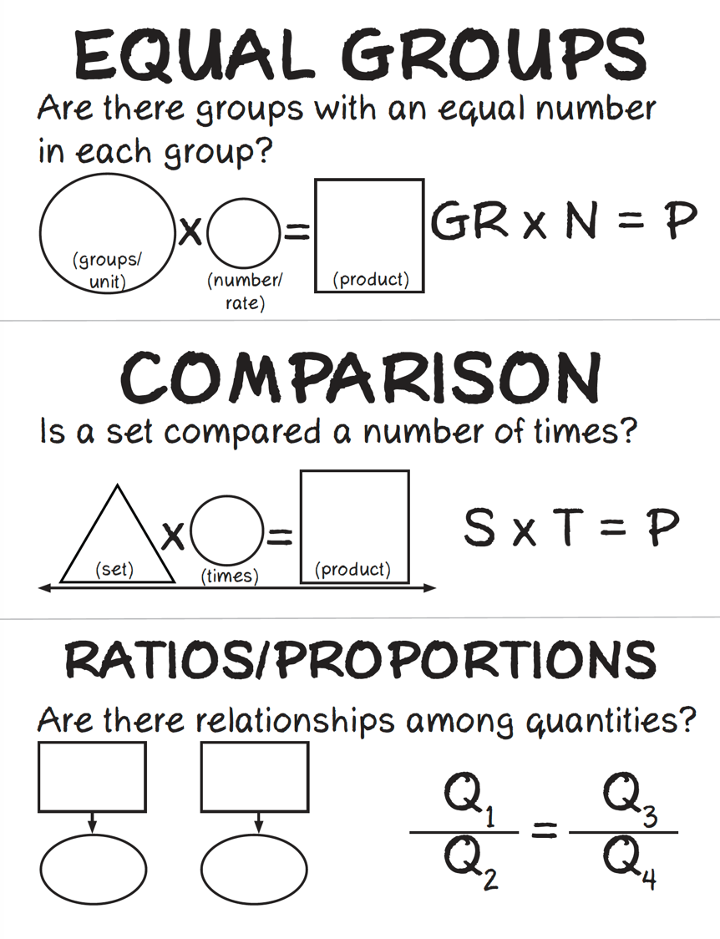

Slide 28
Multi-Step Problems
Use your attack strategy
Use word-problem schemas

Slide 30
Multi-Step Problems
Use your attack strategy
Use word-problem schemas

Slide 31
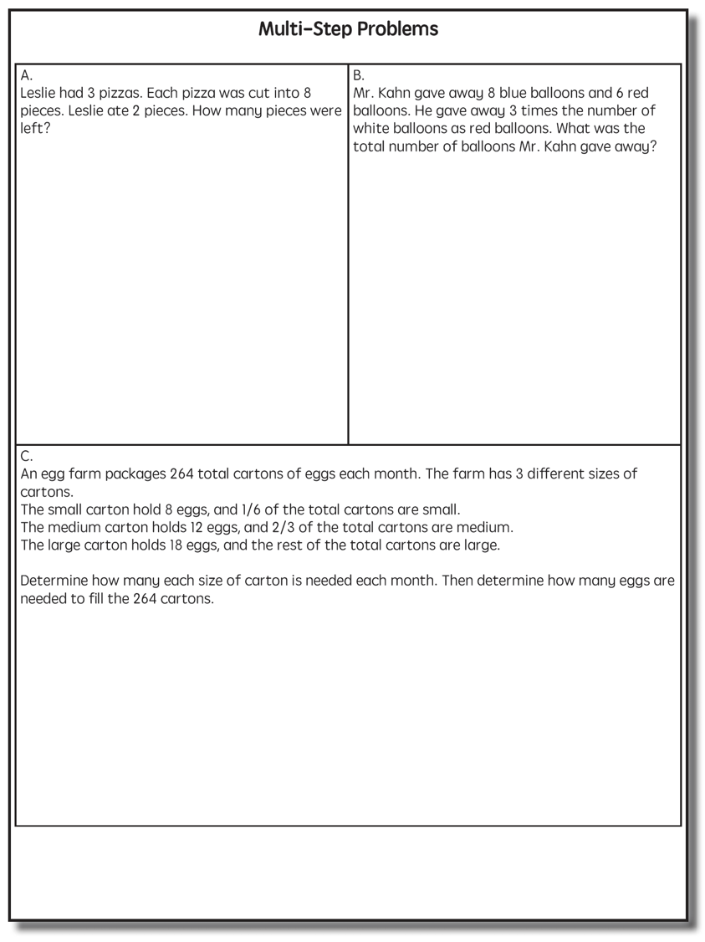

Slide 32
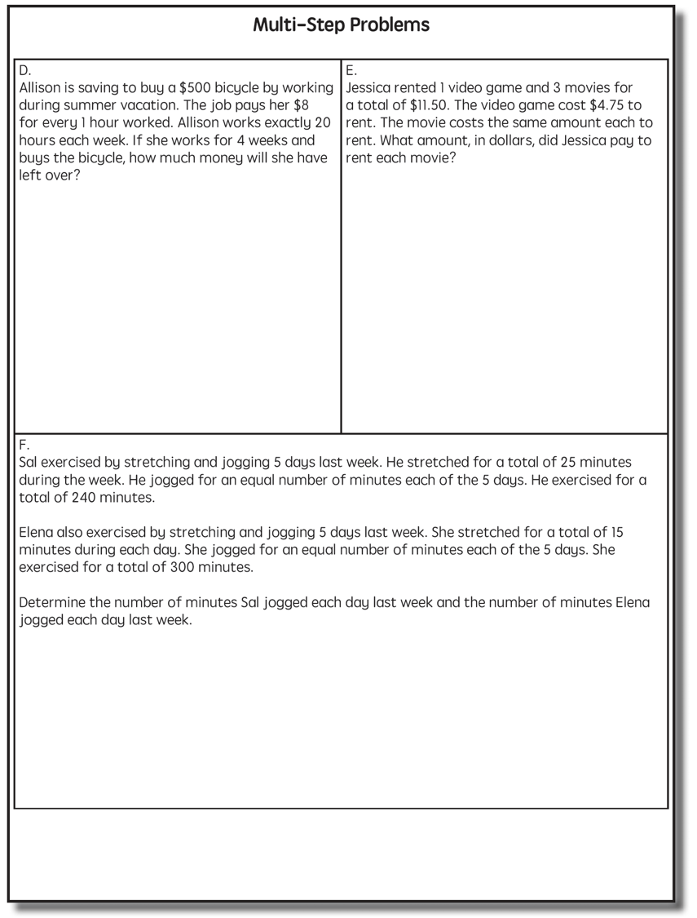

Slide 33
https://jamboard.google.com/d/1m_R2O9nSwwj9B05bSeZ6r2fJQBYp667dk7M3ys2AD1g/edit?usp=sharing

Slide 34
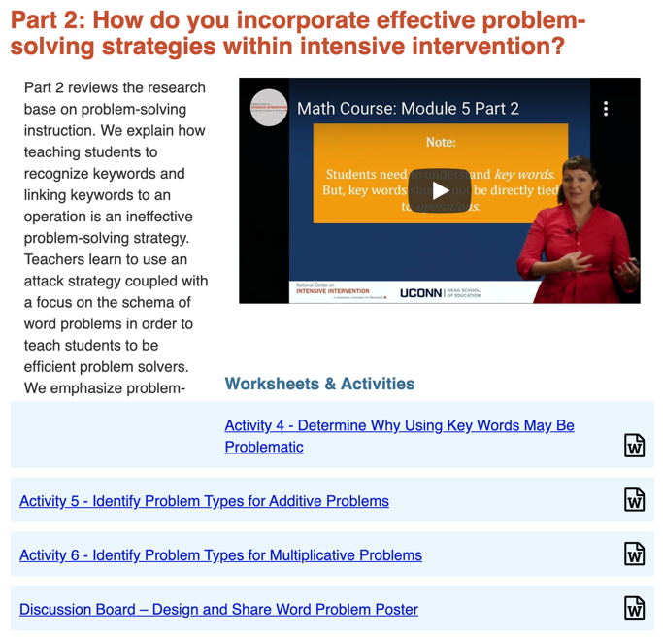
Word-Problem Resources
https://intensiveintervention.org/instructional-strategies-math-course

Slide 35
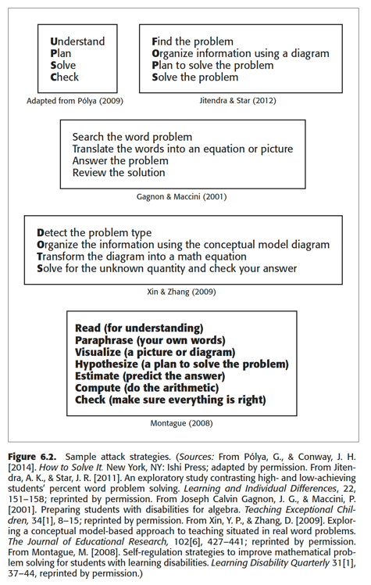
Word-Problem Resources
https://www.amazon.com/Teaching-Math-Middle-School-Students/dp/1598572741

Slide 36
Contact
www.sarahpowellphd.com
srpowell@austin.utexas.edu
@sarahpowellphd
119

